Slide 1

Unit 3.2
Seven Cs of Effective Communication
Completeness

Slide 2
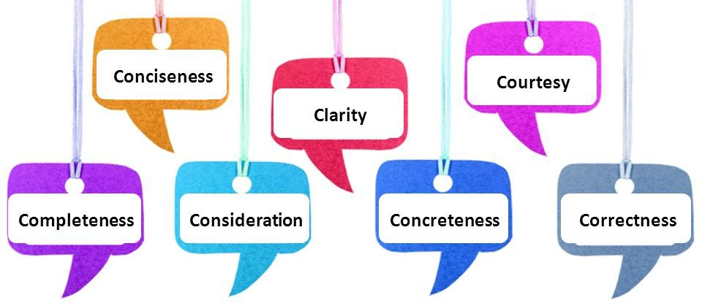
7 Cs of Effective Communication
7 C's of Communication are the principles that help writers and speakers
to communicate effectively. It becomes easier for the sender and the
receiver to share and understand the shared knowledge at the same level of understanding.

Slide 3
Completeness
The message is considered as complete when it includes all the facts and the necessary information to achieve the desired response.
Provide all necessary information by applying 5 W’s checklist.
Who, What, When, Where and Why
Answer all the questions asked.
Give something extra when desired.

Slide 4
Bad Example Good Example
I wanted to inform you that we will have a meeting tomorrow. | I wanted to remind you about tomorrow's meeting regarding ONLINE TEACHING. The meeting will be held in the conference room from 10 am to 11 am.

Slide 5
References
Thill, J. V., & Bovee, C. L. (2013). Excellence in Business
Communication (10th ed.). Pearson.
Guffey, M. E., & Loewy, D. (2016). Essentials of business
communication (10th ed.). Cengage Learning.

